Slide 1
Yoga – Invention of life
Meeting God In A Silent way

Slide 2
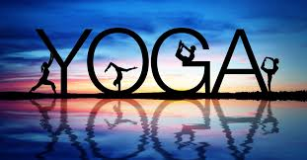

Slide 3
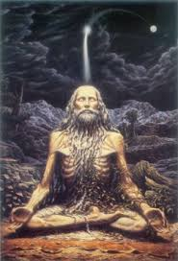
YOGA
Yoga is a physical, mental, and spiritual practice or discipline which originated in India. The father of modern yoga is maharishi patanjali he made yoga easy for common people to practise in daily life

Slide 4

YOGA GIVES US POSIVITY

Slide 5






PEOPLE WHICH DO NOT FEEL POSITIVITY

Slide 6
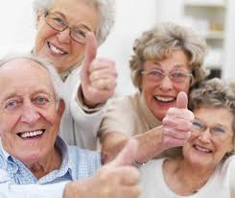





PEOPLE WHICH FEEL POSITIVITY

Slide 7
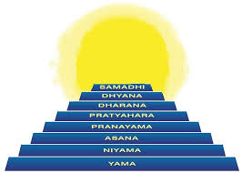
HOW TO FEEL POSITIVITY
BY FOLLOWING EIGHT FOLD PATH OF YOGA

Slide 8
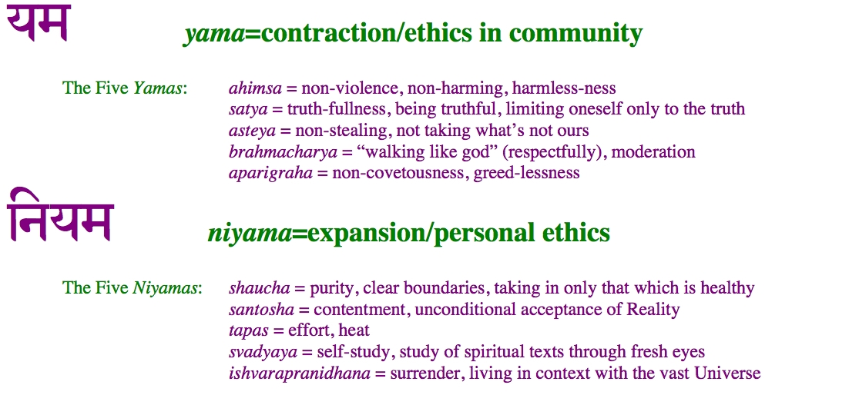
YAMA and NIYAM

Slide 9
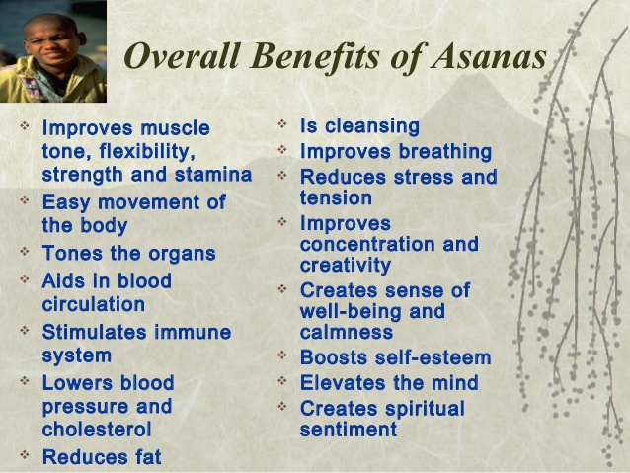

Slide 10
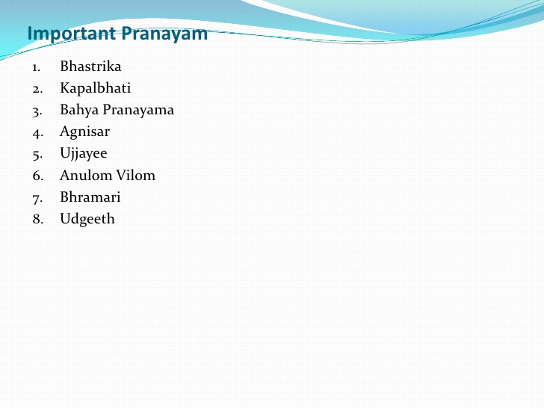

Slide 11
The main goals of “Yoga in Daily Life” are:
Physical Health
Mental Health
Social Health
Spiritual Health
Self-Realisation or realisation of the Divine within us

Slide 12
Types of Yoga Asanas
The Sun Salutation (Surya Namaskar)
Leg Raises.
Basic Breathing (Pranayama)
The Plough (Hala Asana)
The Shoulder Stand (Sarvang Asana)
The Fish (Matsya Asana)
The Bow (Dhanur Asana)
The Lotus (Padma Asana)

Slide 13
YOGA ASANAS

Slide 14


Slide 15
I
Benefits of yoga
Increased flexibility.
Increased muscle strength and tone.
Improved respiration, energy and vitality.
Weight reduction.
Cardio and circulatory health.
Improved athletic performance.
Protection from injury
.

Slide 16
So, stay fit and keep doing yoga.
Thank you
Kalpana Singh

